Slide 1

Admin Script Hoarder to
PowerShell Demigod

Slide 2





About Me
 | Live Services Specialist @ Sage
 | 4 Years PowerShell Trial & Error
 | @BrettMiller_IT
 | https://github.com/brettmillerb
 | https://millerb.co.uk

Slide 3
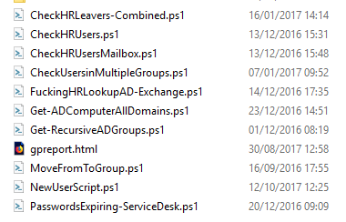
Admin Script Hoarder
Scripts stored locally 😕
Only me that uses them so 🤷‍♂️
No error handling ❌
Hardcoded variables/secrets 😲
No backups 🤦‍♀️
No access control 😱
No way of sharing scripts 🤮

Slide 4
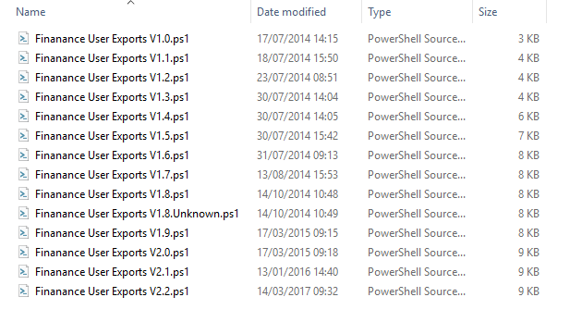
Admin Script Hoarder
This look familiar?

Slide 5
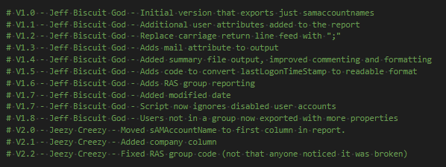
Admin Script Hoarder
What about this?

Slide 6
Sharing is Caring
Sharing code makes you think about:
Error Handling
Consistency
Visibility
Performance
Compatibility
Usability
Security

Slide 7
PowerShell is Code
Should be in Source Control
Should have unit tests
Consistency is key
Pick a style, stick to it
Delivering Value
“Developers who write unit tests write more testable code”
- Nicole Forsgren

Slide 8
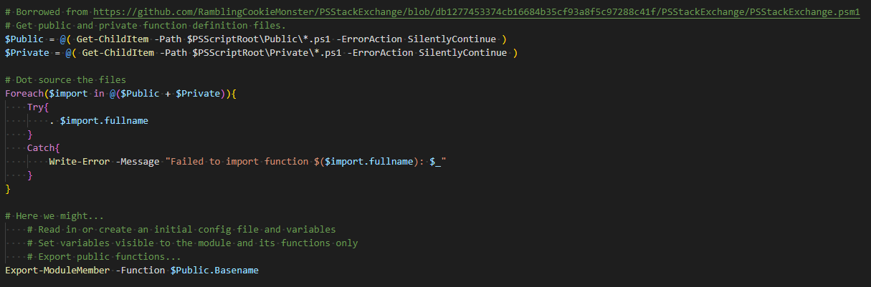
Building PowerShell Modules
Dot Source all of the things!!!
Probably just stolen from someone's blog, it works…..we have no idea why but it does.

Slide 9
Building PowerShell Modules
Demo

Slide 10

Thank You ☺
 | aka.ms/psslack || aka.ms/psdiscord
 | slofile.com/slack/get-psuguk
 | @BrettMiller_IT
 | https://github.com/brettmillerb
 | https://millerb.co.uk

